Slide 1
Internal Assessment-1
Godula Pooja

Slide 2
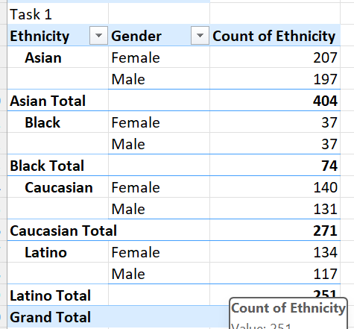
1.Gender and ethnicity in the company

Slide 3
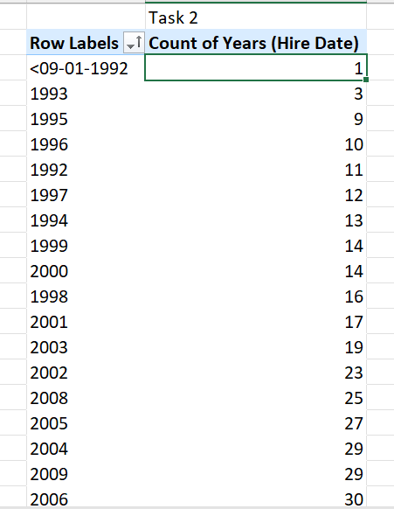
2.Average time of employee staying in the company before leaving

Slide 4
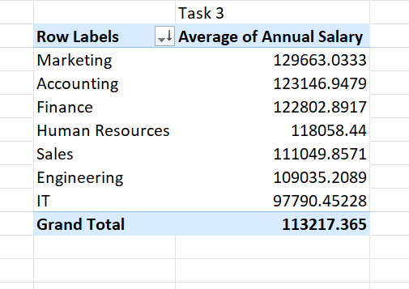
3.Average salary difference between two departments
Difference between marketing accounting and finance is slight and it decreased moderately to finance department.

Slide 5
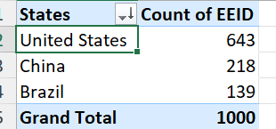
4.Country with highest number of employees
USA has the highest number of employees i.e,643

Slide 6
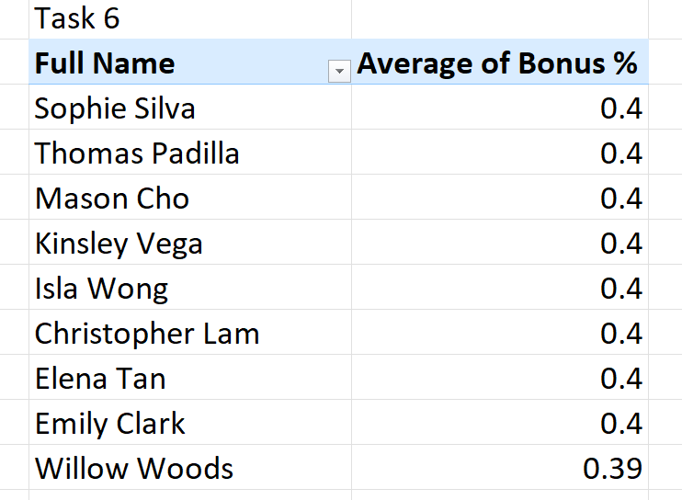
6. Average % bonus given to employees

Slide 7
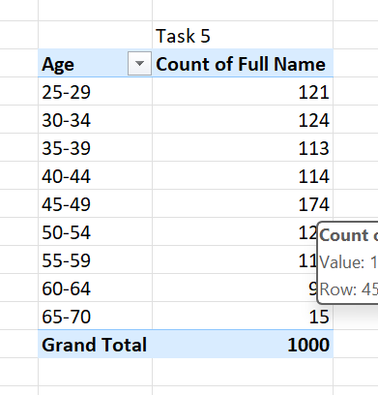
5.Most common age range of employees
25-29 age range people are the highest I,e, 121

Slide 8
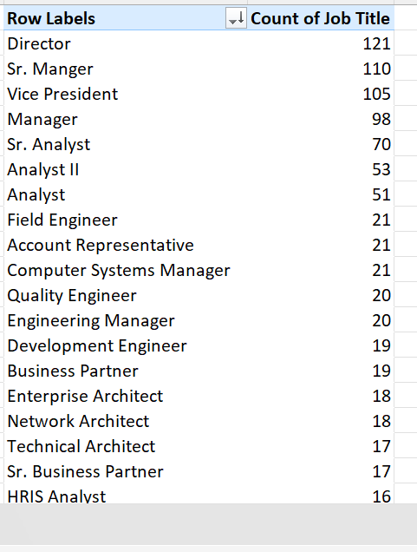
7.Job title which occurred more frequently
Director occurred most number of times i.e, 121

Slide 9
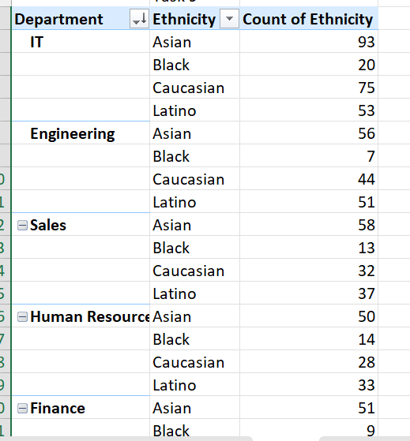
9.Departments diverse in ethnicity comparison

Slide 10
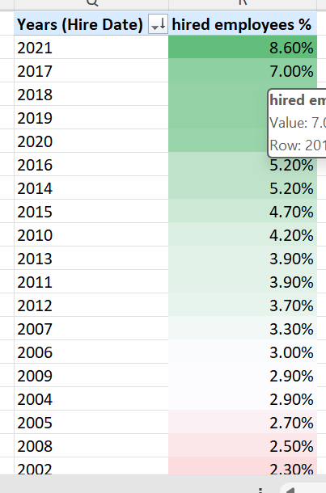
10.Increase or decrease in number of hires

